Slide 1
AgriNova
Smart Agriculture, Marketplace & Decision Support System

Slide 2
Introduction
AgriNova is an integrated digital agriculture platform that connects farmers and buyers through a single web application.
Direct Digital Marketplace: Connects farmers directly with buyers.
AgriBot AI Advisory: Provides farming guidance and crop disease assistance.
Smart Decision Support: Offers mandi prices, weather forecasts, and sales analytics.
Trust & Governance: Supports farmer verification, chat moderation, and dispute management.
Why AgriNova Matters?
Improves access to buyers and market information.
Supports informed farming and selling decisions.
Promotes transparent transactions and safer communication.

Slide 3
Problem Statement
Current Challenges
Farmers depend on intermediaries to reach buyers.
Limited access to transparent market prices.
Difficulty accessing timely farming guidance.
Risk of fraud and unsafe communication.
Manual order tracking and invoice management.
Proposed Solution
Direct farmer-to-buyer marketplace.
Mandi price information and weather forecasts.
AI-powered AgriBot for farming assistance.
AI-based chat moderation and farmer verification.
Digital orders, tracking, and invoice generation.

Slide 4
Project Definition & Objectives
Project Definition
AgriNova is a full-stack web application that connects farmers and buyers through a direct agricultural marketplace, AI-powered farming assistance, market information, and secure digital transaction management.
Key Objectives
Direct Marketplace: Enable farmers to list and sell agricultural products directly to buyers.
AI Assistance: Provide farming guidance through AgriBot.
Market Transparency: Provide mandi prices and weather information.
Smart Communication: Support real-time messaging and AI-based chat moderation.
Secure Management: Manage users, orders, farmer verification, and support requests.

Slide 5
Project Profile
Parameter | Details
Project Name | AgriNova
Project Domain | Agriculture & E-Commerce
Project Type | Full-Stack Web Application
Architecture | Client-Server Architecture
Frontend | React.js, Vite, Tailwind CSS
Backend | Node.js, Express.js
Database | MongoDB Atlas
AI Integration | Groq API
Image Storage | Cloudinary
Communication | Socket.IO
Authentication | JWT & Google OAuth 2.0
Deployment | Vercel & Render

Slide 6
Tools and Technology Stack
Layer | Tools & Technologies
Frontend | React 19, Vite, Tailwind CSS
UI & Animations | Framer Motion, Lucide React
Data Visualization | Recharts
Maps | Leaflet, React-Leaflet
Backend | Node.js, Express.js
Real-Time Communication | Socket.IO
Authentication | JWT, Google OAuth 2.0, Bcrypt.js
Database | MongoDB Atlas, Mongoose
Image Storage | Cloudinary, Multer
AI Integration | Groq Cloud API
Email Services | Nodemailer
PDF Generation | jsPDF, jsPDF-AutoTable
Deployment | Vercel, Render
Development Tools | VS Code, Git, GitHub

Slide 7
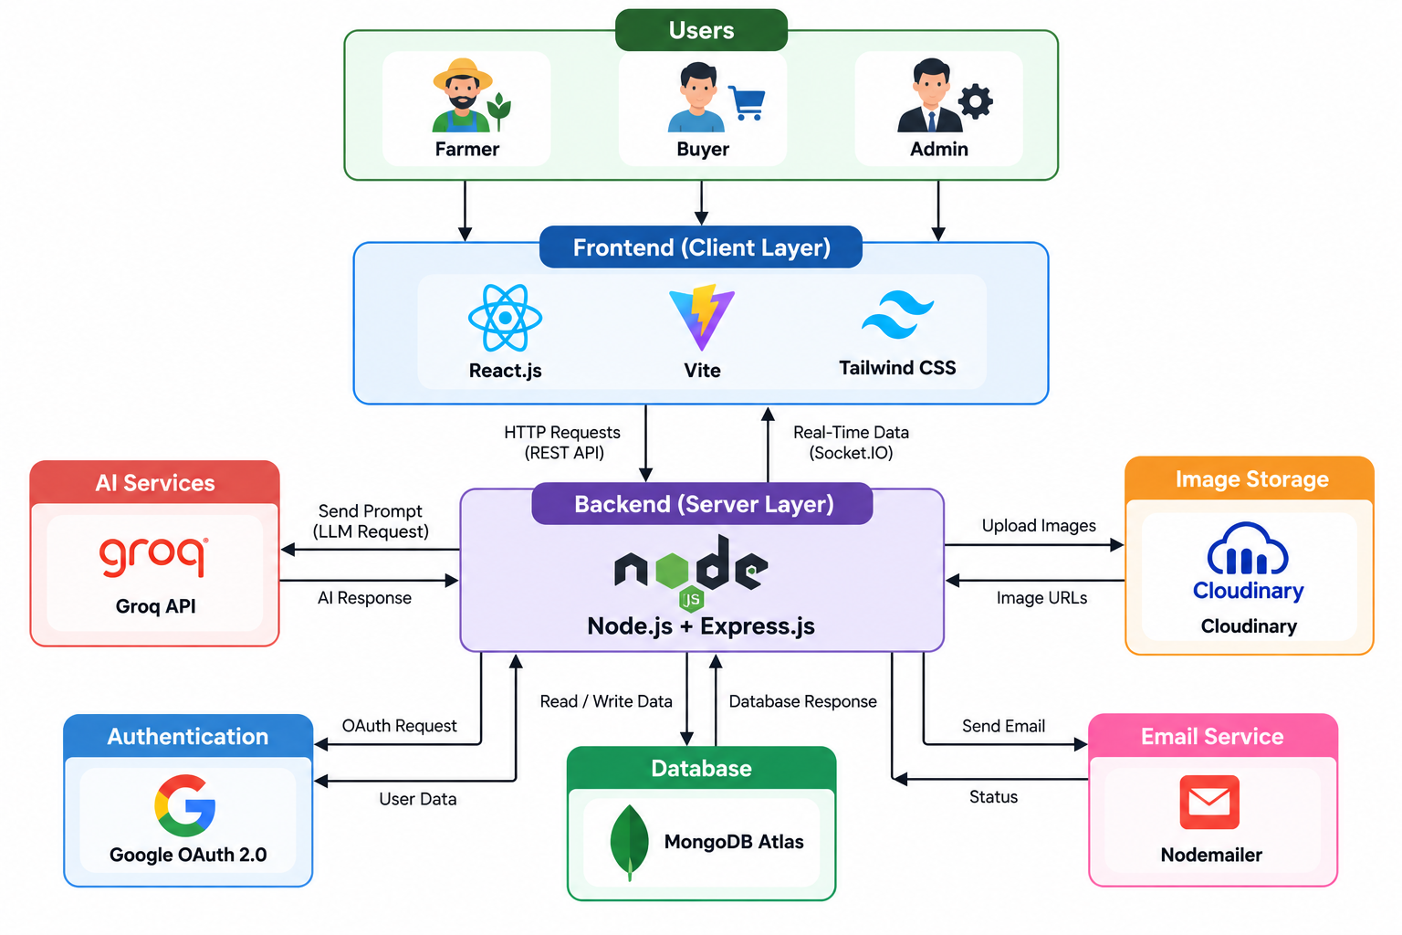
System Architecture Diagram

Slide 8
Key System Modules
Authentication & User Management
  User Registration and Login
  JWT & Google OAuth Authentication
  Role-Based Access Control
Marketplace & Order Management
  Agricultural Product Listings
  Cart and Order Processing
  Order Tracking and PDF Invoices
AgriBot & AI Moderation
  AI-Powered Farming Assistance
  Chat Content Moderation
  Inappropriate Message Detection
Agricultural Decision Support
  Mandi Price Information
  Weather Forecasting
  Sales and Inventory Analytics
Admin & Governance
  Farmer Verification
  User and Category Management
  Support Tickets and Flagged Messages

Slide 9
USERS OF THE SYSTEM
1. Farmer
  Manage profile and farm details
  Add and manage agricultural products
  Track orders and sales
  Access mandi prices and weather forecasts
  Chat with buyers and use AgriBot
2. Buyer
  Browse and search agricultural products
  Add products to cart and place orders
  Track orders and download invoices
  Chat with farmers
  Submit ratings and reviews
3. Admin
  Verify farmer accounts
  Manage users and product categories
  Monitor orders and platform activity
  Review flagged messages
  Manage support tickets

Slide 10
CORE FUNCTIONALITIES — MARKETPLACE & DIRECT TRADE
1. Product Listings
  Add agricultural products with images
  Set price, quantity, and unit
  Display harvest date and product details
2. Search & Filtering
  Search products by name
  Filter by category and price
  Explore available products easily
3. Cart & Order Management
  Add products to the shopping cart
  Validate product stock
  Place and track orders
4. Reviews
  Rate and review products
  View product ratings and feedback

Slide 11
CORE FUNCTIONALITIES — AGRIBOT & AI MODERATION
1. AgriBot AI Assistant
  Provides AI-powered farming guidance
  Answers crop and pest-related questions
  Offers soil nutrient and planting advice
  Generates easy-to-understand responses
2. AI Chat Moderation
  Analyzes farmer–buyer messages
  Detects inappropriate or abusive content
  Flags potentially suspicious messages
  Promotes safer platform communication
3. Technology Used
  Groq API for AI integration
  Large Language Model (LLM)
  Real-time messaging using Socket.IO

Slide 12
CORE FUNCTIONALITIES — DECISION SUPPORT, MANDI & WEATHER
1. Mandi Price Information
  View agricultural market prices
  Compare prices before listing products
  Support informed selling decisions
2. Weather Dashboard
  Display local weather forecasts
  View temperature, humidity, and wind speed
  Monitor rainfall and weather conditions
3. Sales Analytics
  Visualize monthly sales and revenue
  Identify top-selling agricultural products
  Monitor pending orders and inventory
4. Technology Used
  Weather API for forecast data
  Recharts for data visualization
  Location-based weather information

Slide 13
ADMIN GOVERNANCE & VERIFICATION
1. Farmer Verification
  Review farmer verification requests
  Validate farm details
  Display verification status
2. User Management
  Manage farmer and buyer accounts
  Monitor user activity
  Manage account access and status
3. Platform Monitoring
  Monitor orders and platform activity
  Review flagged messages
  Track key dashboard statistics
4. Support & Category Management
  Manage customer support tickets
  Update agricultural product categories
  Track ticket status and priority

Slide 14
KEY HIGHLIGHTS & COMPETITIVE ADVANTAGES
1. Direct Farmer-to-Buyer Marketplace
  Reduces dependence on intermediaries
  Enables direct product discovery and trade
2. AI-Powered Farming Assistance
  AgriBot provides farming-related guidance
  Supports crop and pest-related queries
3. Smart Agricultural Insights
  Mandi price information
  Weather forecasts and sales analytics
4. Trust & Security
  Farmer verification
  AI-based chat moderation
  Ratings and reviews
5. Digital Management
  Online order tracking
  PDF invoice generation
  Centralized platform administration

Slide 15
FUTURE SCOPE & ENHANCEMENTS
1. Online Payment Integration
  Secure payment gateway integration
  Digital transaction tracking
2. IoT-Based Smart Farming
  Soil moisture monitoring
  Sensor-based irrigation recommendations
3. Multilingual AI Assistant
  Gujarati and Hindi language support
  Voice-based farming assistance
4. Crop Disease Detection
  Image-based disease identification
  AI-powered crop health recommendations
5. Smart Logistics
  Delivery tracking
  Cold-chain and storage management

Slide 16
CONCLUSION
AgriNova connects farmers and buyers through a digital marketplace.
AgriBot provides AI-powered farming assistance.
Mandi prices and weather forecasts support informed decisions.
Order management and chat moderation improve platform usability and trust.
The platform promotes digital transformation in agriculture.

